Slide 1
Industry 4.0
The fourth industrial revolution: the digitization of production processes and the necessary skills
PROF. ING. ETTORE MARASCHI

Slide 2
Industrial revolutions
The industry has gone through four revolutions linked to major technological innovations

Slide 3
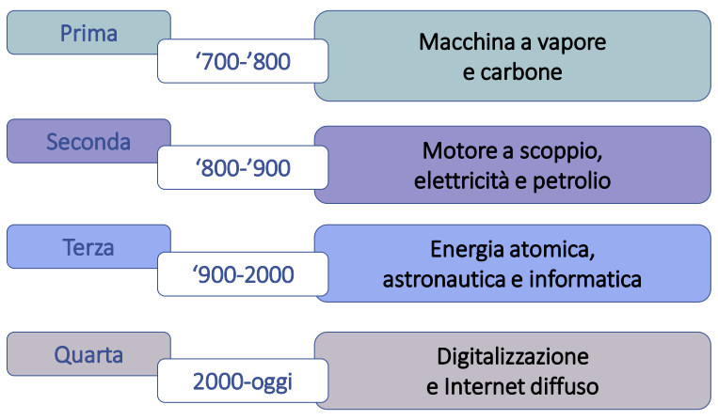
First
Steam and coal machine
Second
Internal combustion engine, electricity and oil
Third
Atomic energy, astronautics and computer science
Fourth
Digitization and widespread internet
Today

Slide 4
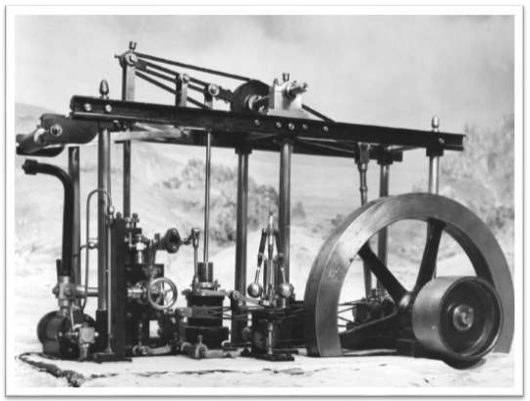
First revolution and technology
Multiplication of force
Production detaches itself from physical force,human or animal

Slide 5
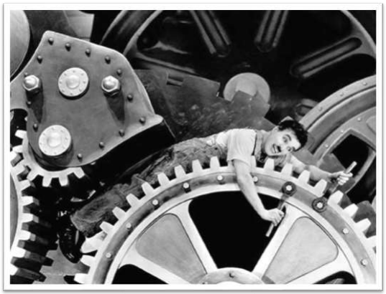
Second revolution and technology
Multiplication of the scale
Electricity can be easily
transported and can connect production units placed in
distant places

Slide 6
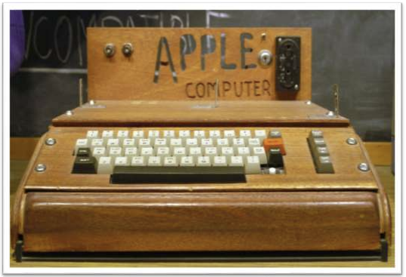
Third revolution and technology
Speed multiplication
Information can be processed and managed more quickly

Slide 7
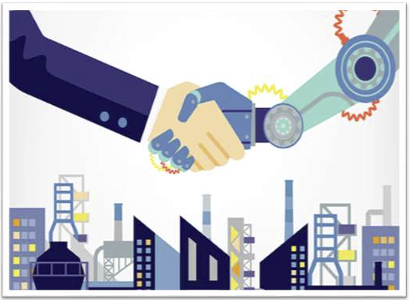
Fourth revolution and technology
Multiplication of flexibility
Increasingly pervasive use of intelligent components and systems

Slide 8
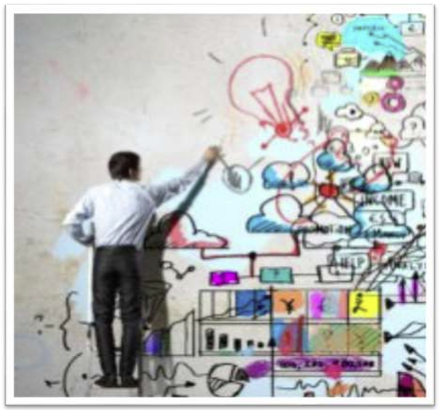
Fourth revolution and technology
In the midst of the Fourth Industrial Revolution,the manufacturing sector is going through a huge change with significant impacts on the entire Supply Chain:
the old paradigms that influenced production and distribution are behind us, and yes it is outlining a whole new in challenges and opportunities

Slide 9
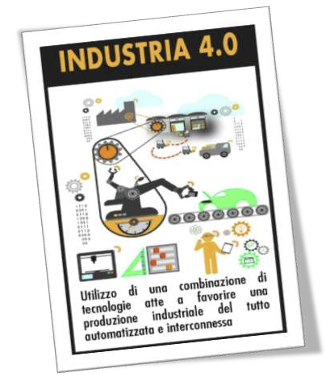
Term "Industry 4.0"
The term «Industry 4.0», synonymous with fourth industrial revolution, it appeared for the first time in 2011 in Germany at the Hannover fair, understood as transformation and digital evolution of manufacturing

Slide 10
Industry 4.0 paradigm
Objects and machines will contain all the necessary information within themselves to production and the product will become the center of this transformation process.
The product will carry within itself all the information necessary for its realization and the machines will be able to coordinate by sharing information and sharing the work
We are not talking about building only a "nervous system" through the use of technologies enabling such as those that come from the IT world, but also to create a shape of distributed intelligence that makes processes become autonomous and able to self-regulate

Slide 11
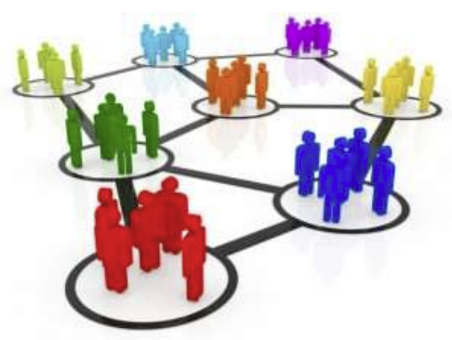
Key component of Industry 4.0
All processes will be inserted in inter-company networks and will be characterized by an integrated engineering that thinks is the manufacturing process both to the product, in the at the same time an element of intelligence and of observation of the entire process

Slide 12
Industry 4.0: similar experiences
Netherlands
Smart Industry
France
Industrie du Futur
USA
Advanced Manufacturing

Slide 13
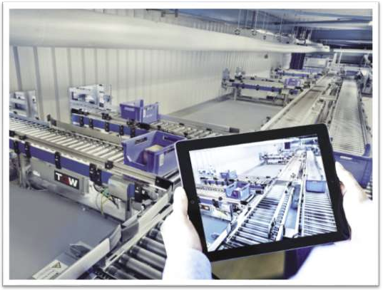
Digital technologies: current applications
Industrial process control
Repetition of the same action / task
Remote control of machinery
The total digitalization of processes production and logistics is still a long way off

Slide 14
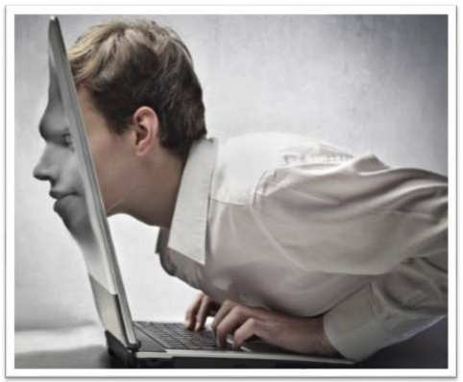
Cyber-physical systems
Fusion of virtual and real world
Products and components will be made smart from the integration of sensors, processors, units of memory and transmitters
All this will not only enable machines to communicate with each other, but also to carry out of autonomous choices without interaction with the man

Slide 15
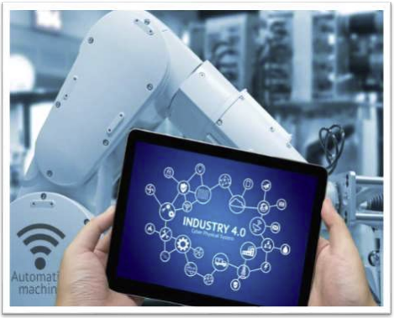
Cyber-physical systems
Networked machines will not only produce more and with fewer errors, but also independently modify the production schemes according to inputs external receiving while maintaining a high efficiency
Through the installation and dissemination of digital technologies in production there will also have the opportunity to implement effective simulations on the various lines of production

Slide 16
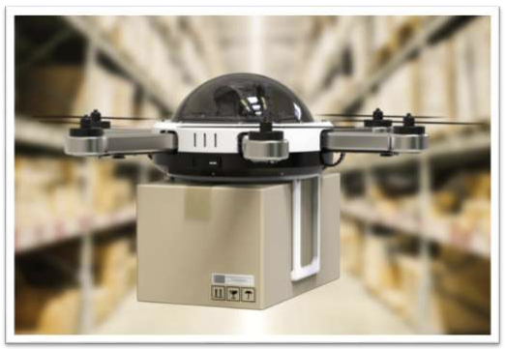
Digital innovations and logistics
Logistics will also be affected by digital innovations, through the implementation of transport systems automated, including drones, within warehouses, sheds and medium-sized companies big dimensions
Such vehicles, capable of navigating and moving around in an intelligent and independent way inside of the factory, will reduce the need fora high presence of dedicated staff to the handling of materials and to the warehouse management.

Slide 17
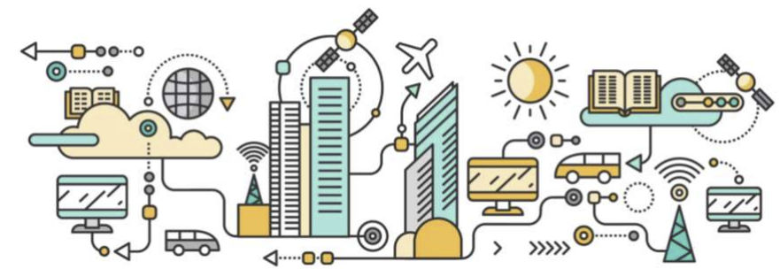
Smart Manufacturing
Lo Smart Manufacturing è il risultato dell’adozione di tecnologie digitali capaci di aumentare l’interconnessione e la cooperazione delle risorse (asset fisici, persone ed informazioni) usate nei processi operativi, sia interne alla fabbrica sia distribuite lungo la catena del valore

Slide 18
Digitization of the manufacturing sector
The implications of the digitization of the manufacturing sector are manifold, but can be summarized in a few areas:
Availability of digital data and analytics of "Big Data"
Robotics and advanced automation
Push connectivity and integration of the value chain
Digital contact with the customer and sharing economy

Slide 19
Founding technologies
Internet of Things
big-data
cloud computing
wearable device
augmented reality
additive manufacturing

Slide 20
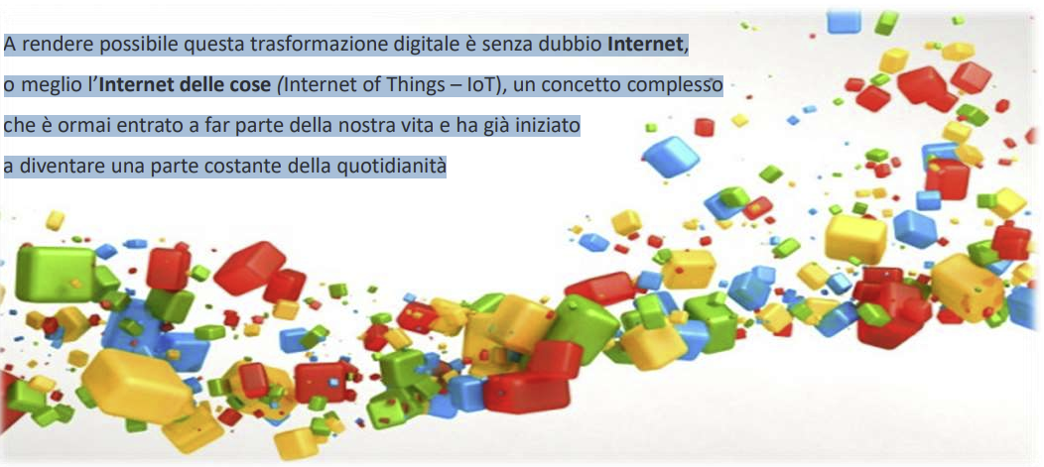
Digital transformation
What makes this digital transformation possible is undoubtedly the Internet, or rather the Internet of Things (IoT), a complex concept which has now become part of our life and has already begun to become a constant part of everyday life

Slide 21
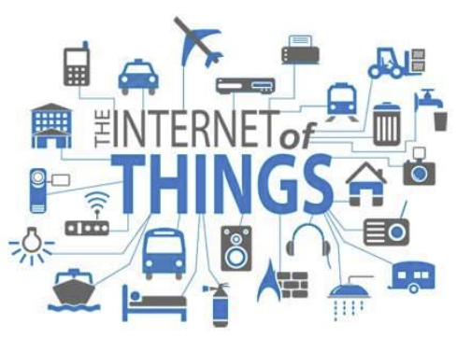
"Internet of things (objects)"
The expression "Internet of Things" or moreproperly "Internet of Things" is aneologism referring to the extension of the Internet to theworld of concrete objects and places
“The physical world connected to the Internetthrough a network of distributed sensors "[Kevin Ashton]

Slide 22
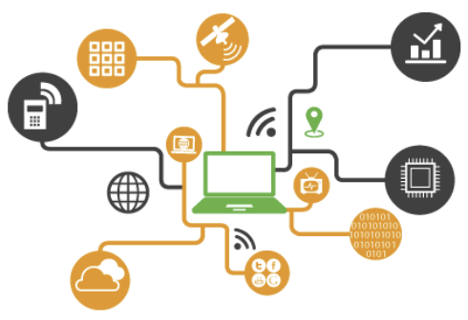
"Internet of things"
The expression "Internet of things" (Internet of Things - IoT) indicates an integrated system of intercommunicating and intelligent devices that connects, through the network, objects, people and places, ensuring the interface between the physical and digital world.
The ultimate purpose of such technological solutions is basically to monitor, check and transfer useful information for carry out consequent actions.

Slide 23
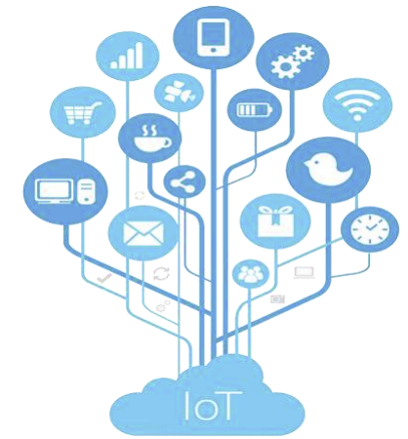
"Internet of things"
If you wanted to briefly indicate what mean the expression "Internet of Things" it describes a path in development technological under which, through the network Internet, potentially every object of the our daily life acquires its own identity in the digital world.

Slide 24
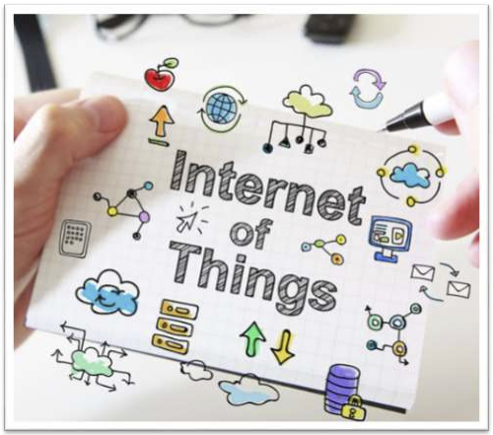
Internet of things: purpose
The internet of things has only one purposeto improve the quality of our life,facilitate everyday life by going to playtasks for us and to add more that before we could not have thought of doing from alone in order to optimize each activity, reduce the dangers and limit human error

Slide 25
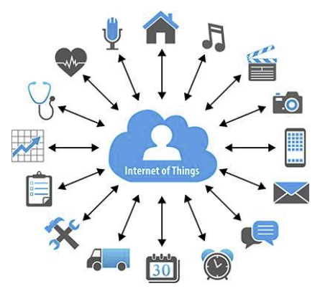
Internet of things: potential
Through the Internet of things, objects ("things") make themselves recognizable and acquire intelligence thanks to the fact that they can communicate data about themselves and access aggregate information from others.
The goal is that the electronic and computer world can overlap the real one, in which objects can have an electronic identity related to the physical environment.
The internet of things can in fact link anything, any object, as long as it has software that allows it to communicate and exchange data with other objects equally connected on the same network and, in this perspective, all objects can acquire an active role thanks to the connection to the Network.

Slide 26
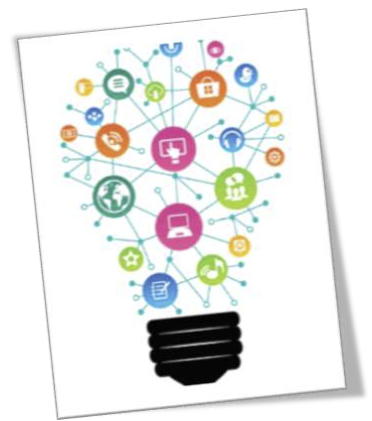
Internet of things = invention
It is difficult to define the IoT as an invention ...
… It is rather a new modality use of the Internet within the physical space

Slide 27
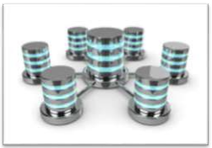
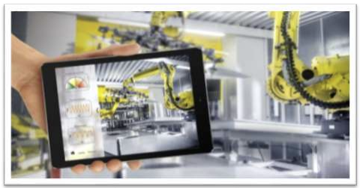
Internet of things in the industrial field
The "translation" of the concept of “Internet of things ”In the industrial field, it identifies birth of the "Factory 4.0", that is an environment in the such as intelligent machines, devices and people are connected to each other ...
… This interconnection leads to ability to make better decisions through extensive and analytical data bases advanced that lead to the evolution towards new forms of business; an evolution for the which factories will be more and more intelligent and interconnected with each other.

Slide 28
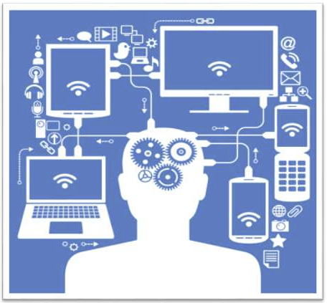
Internet of things (IoT) and Sensors
The Internet of Things (IoT) will play an increasingly predominant role and will offer manufacturing companies a greater level of intelligence to make typical processes in the supply chain more profitable.
Thanks to sensors (RFID chips, QR codes, etc.) incorporated into the products, it will be possible to track these items in real time throughout the entire Supply Chain, enabling much more efficient planning and production.
Other intelligent sensors connected to the products will actively communicate to machinery and production equipment which next processing steps are required.

Slide 29
Huge availability of data, intelligent information and objects
Huge availability of data:
The huge availability of data and information will be able to influence indiscriminately the production process, business models and creation(replacement or elimination) of products.
Equally interesting for the effects on business models of enterprises is the dissemination of products and objects "Intelligent" (smart) on the markets: the diffusion of the IoT, therefore, could fostering profound changes in business and in value extraction strategies.

Slide 30
Demand forecast
In the past it relied solely on factors such as seasonality, trends and historical data
Social media has become a good indicator of buying behaviors
Internet of Things will also support future planning and satisfaction of the request

Slide 31
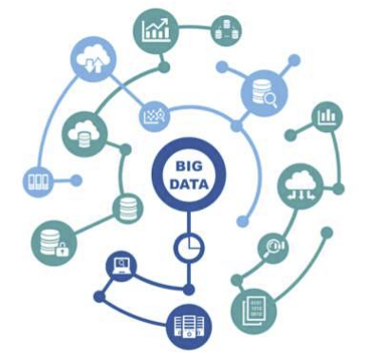
Big-data
The term big data is somewhat misleading.
Big data revolution
≠
lots of information at the service of business
Big-data revolution
=
use the information to process, analyze and find feedback on various issues

Slide 32
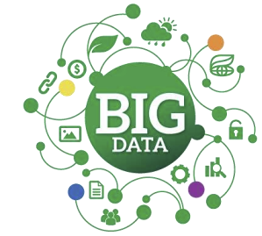
Availability of digital data and analytics of "Big Data"
The digital economy promises potential new economy.
Businesses must go digital more mature.
The processing and analysis of huge quantities of data (Big Data) at ever lower costs allows better decisions and predictions on production and consumption, as well as development of on-demand production systems with capacity for personalized responses e immediate to the consumer.
One of the bets of Industry 4.0 consists in the formalization of the knowledge through its translation into data and its exploitation through adequate analysis models.

Slide 33
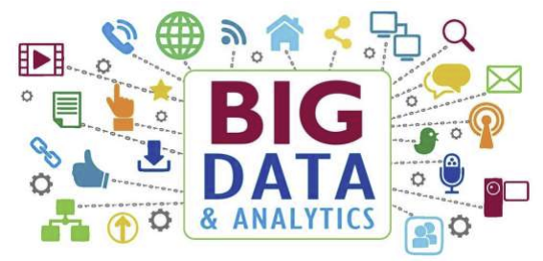
Big data technologies
In the virtual world, Big-Data technologies (commonly called Big-Data Analytics) allow you to analyze, integrate and manage the huge amount of data collected ("raw" data generated by devices in the physical environment), extracting knowledge, on the basis of which it becomes possible to identify actions to be performed on the objects themselves to configure them and, in some cases, acting on the physical world around them

Slide 34
"IT cloud"
Cloud
Cloud computing
Space of data and services which turns out to be accessible using an Internet connection
Allow access for free or a very low costs for programs and services via the cloud
Cloud storage
Cloud storage & computing
It is a sort of huge digital archive connected to the Internet
It allows quality leaps in management, data processing and storage

Slide 35
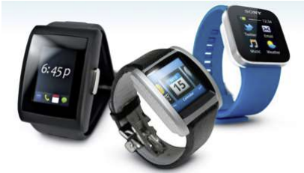
"Wearable" devices
A wearable device is part of a type of electronic device that are worn, usually on the wrist, and which, thanks to specific sensors and / or actuators, are in able to use wireless networks to communicate and exchange information with each other, but also to increase the ability to read and see physical reality, facilitating any activity. Some types of wearable devices are for example:
"smart watches and glasses,
augmented reality viewers,
etc.

Slide 36
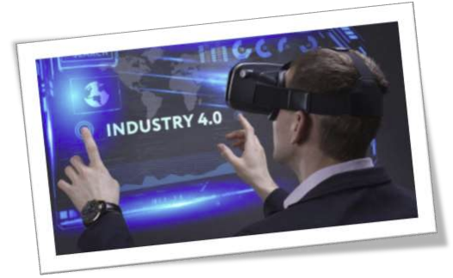
Wearable devices: the advantages
Better use of the workforce
Visibility on production indicators
Information in real time
Better management of "alerts"
The connection of the industrial operator to the digital world through "wearable" devices can therefore improve the efficiency and safety of workers directly or indirectly

Slide 37
Augmented reality
It is the enrichment, with additional data in digital format, of information already mentioned we normally have about the activities, simple or complex, that we carry out during the day.
It is also the integration and enhancement of the possibilities offered to us by our people five senses with high-tech devices.
It should not be confused with virtual reality; the latter creates a totally artificial environment, built on the computer, and makes it believable by making use of technologies that give the feeling to those who use them to be really immersed in that scenario.
It is characterized in fact by the high flexibility to adapt to different contexts and needs with a minimum of technological support to use virtual multimedia content.

Slide 38
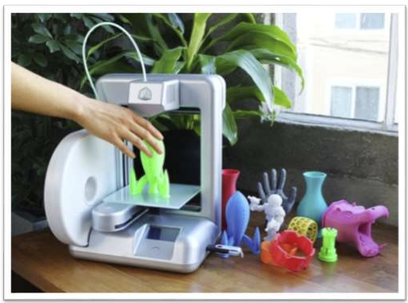
Additive manufacturing
Additive manufacturing (or 3D printing) is a production method that, using technologies that are also very different from each other, allows the creation of objects (parts components, semi-finished or finished products) generating and summing successive layers of material.
3D printing makes it possible to produce i goods "alleging" material, in contrast to the traditional production by subtraction, using innovative production processes and materials, so much so that the products are "printed" in production phase through special 3D printers

Slide 39
Additive manufacturing: the advantages
Low volume products will be manufactured locally and on demand
drastically reducing design times and production cycles,
positively impacting on construction and shipping costs,
eliminating the problems related to inventory management,
favoring personalization, including for consumer products.
An indispensable prerequisite for this evolution, however, is the flexibility of supply chains in the manufacturing sector, which will have to become much more agile and operate according to logic real-time and on-demand.

Slide 40
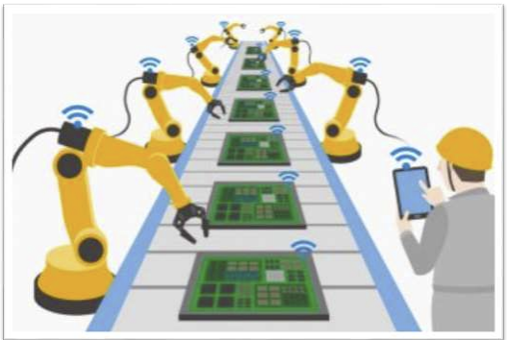
Factory 4.0 and "intelligent machines"
Introduction of "external" elements to the machine that allow you to interact with the surrounding world
Smart machines supervised by dedicated control systems that they promote flexibility and interconnection with other systems
Cyber-physical places where the real world is the digital world will integrate

Slide 41
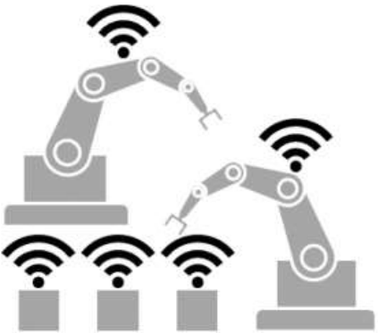
Production and interaction “machine-machine”
The production will include direct interaction "Machine-machine" , as well as "man-machine". Thanks to this interaction, a continuous circular process of data production, data analysis and maintenance and reconfiguration of production processes, the effects of which, in part already observable, are disruptive:
previously unimaginable levels of flexibility,
high product customization,
dialogue in real time (or in any case reduced) between market, design, suppliers and production

Slide 42
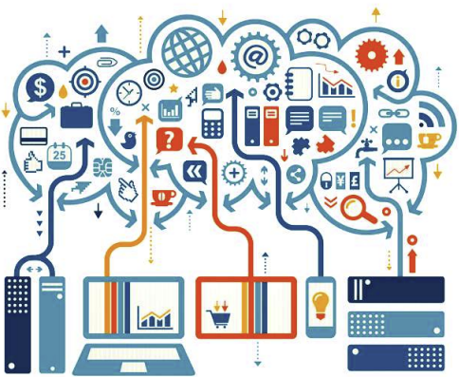
Robotics and advanced automation:
cyber-physical systems
With the introduction of the concepts of "Internet of Things" and the move towards Industry 4.0, it is possible to manage global networks that incorporate and integrate machinery, logistics systems and production structures, in the form of cyber-physical production systems, or intelligent systems that, integrating cybernetic technologies, allow an immediate and flexible interaction with the elements of the physical reality in which they are immersed

Slide 43
Robotics and advanced automation:
cyber-physical systems
New possibilities of complex human-machine interaction and artificial intelligence in fact, they allow a reduction of errors, times and costs and an improvement of productivity and process safety.
Through cyber-physical production systems it is also possible to develop a new one “Modular production automation” where the control systems are composed of more intelligent elements, able to adapt in real time to the context in a system where the robot is integrated with the human workforce in a complete and safe way, giving life to processes production even more streamlined and efficient.

Slide 44
Segmentation of the supply chain
The ability to segment supply chains will also become indispensable (Supply Chain) to reconcile customer requests with the need to maximize the profitability of production processes.
The segmentation of the Supply Chain can in fact contribute significantly to the economic profitability and the differentiation of goods and services offered by businesses manufacturing.
In other words, the segmentation of the supply chain represents a business process and a key ability to ensure that business objectives are achieved despite criticalities that characterize daily operations.

Slide 45
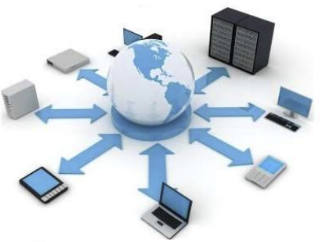
Pushed connectivity and value chain
Modern manufacturing requires deeply connected factories and ICT environments. In many industrial plants this connection is still based on proprietary and realized systems for a single customer, but these protected areas are already in fact attacked by technologies Internet thanks to which the scope of Industry 4.0 can go beyond the single one business.
Thanks to interconnection through fixed devices and furniture, the entire value chain is shortened and synchronizes by improving the time of arrival on the market (time to market) and the ability to respond, even to anticipate, the tastes of customers, allowing the scale production even for very small batches (mass customization).

Slide 46
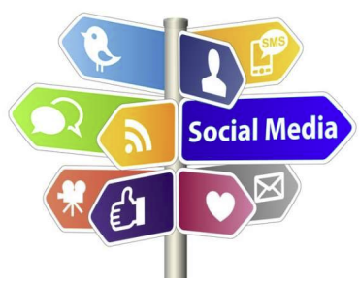
Digital contact with the customer and
sharing economy
Internet and social media offer new channels of interaction with the consumer e push towards the definition of new services and business models.
To create suitableplatforms for the sharing of ideas, knowledge and experiences it is necessary to adopt internationally common rules to enable the interoperability of systems and languages that govern Industry 4.0.
It is also essential to invest in development of digital skills of workers to facilitate daily use of new technologies.

Slide 47
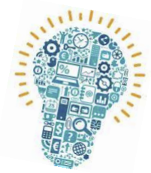
Industry 4.0 and manufacturing Italian system
It is not merely about doing "old things" in an innovative way. It's about doing "new things" in "new ways"
Successful businesses must be enabled to grow and develop.
Institutions must create the enabling conditions for companies to work, experiment and develop.
Businesses must be ready to open their horizons.

Slide 48
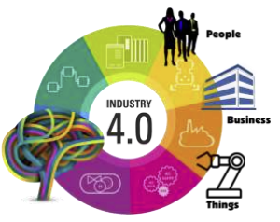
Industry 4.0 and Italian manufacturing system
The digital revolution of Industry 4.0
It leverages the skills of our production system
Value large amounts of data
Promote highly customized manufacturing
Take advantage of the slenderness and flexibility of Italian Small and Medium Enterprises
Create tighter supply chain integration
It favors the spread of innovation and new digital and non-digital technologies
Create the conditions for a more advanced dialogue with the financial world

Slide 49
A new way of thinking about the factory
Among the technologies that fall within the concept of Industry 4.0 some have existed for some time and, in part, are already in use in companies. The real novelty of the Industry 4.0 paradigm consists of a new way of thinking about the factory and the relationships between suppliers, producers and customers and between man and manchine. Industry 4.0 expands externally towards a Supply Chain 4.0:
Integrated communication
Machine-machine and man-machine interaction
Greater automation
Industry 4.0 represents a real new economic model for the industrial world

Slide 50
Role of the worker
In the past …
In the future …
He was relegated to a purely role operational and partially already replaced by automation and robotics in manual work extremely repetitive
It will be increasingly needed forset up the complex machinery (as well as resolve any anomalies) in order to obtain to the better than desired by the customer

Slide 51
Industry 4.0 and the "world" of work
Duties of the worker
Hours and places of work
Skills of the worker
Vision of the work

Slide 52
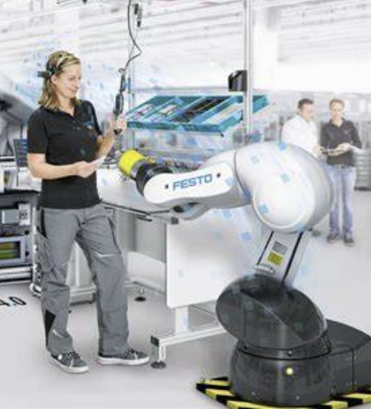
Duties of the worker
Many tasks will be assigned to autonomous machinery
Human-machine interaction will intensify

Slide 53
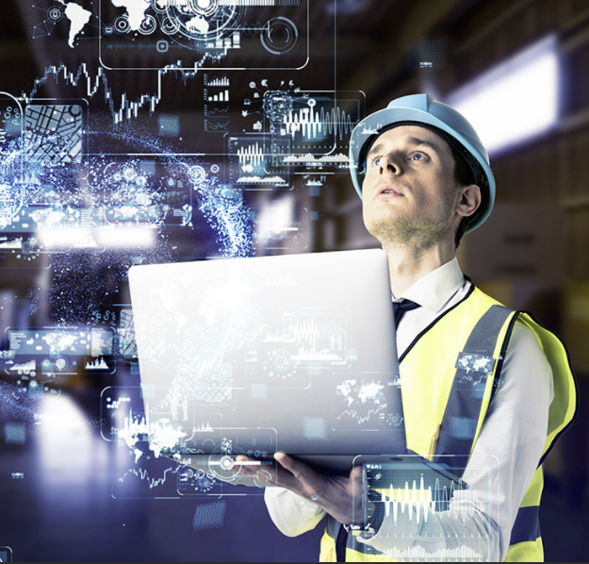
Hours and places of work
As production is managed virtually,nothing prevents a worker from controlling it remotely
The use of cyber-physical systems will allow more flexible working hours and the possibility of working remotely

Slide 54
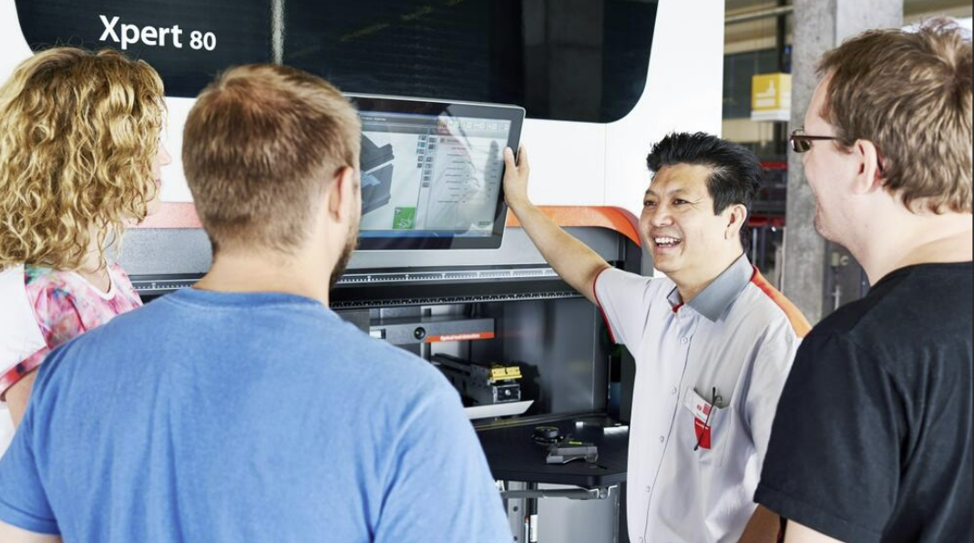
Skills of the worker
Advanced knowledge of information systems it will be the basis for the workers of the future In Industry 4.0, skills become the central aspect.
The relationship between business and training changes, according to a concept of "training company"

Slide 55
Vision of the work
The drastic reduction in the manual contribution of the workersuggests the disappearance of its own value inside the factory.
The machines "move the center"from physical and manual work to creation and design work

Slide 56
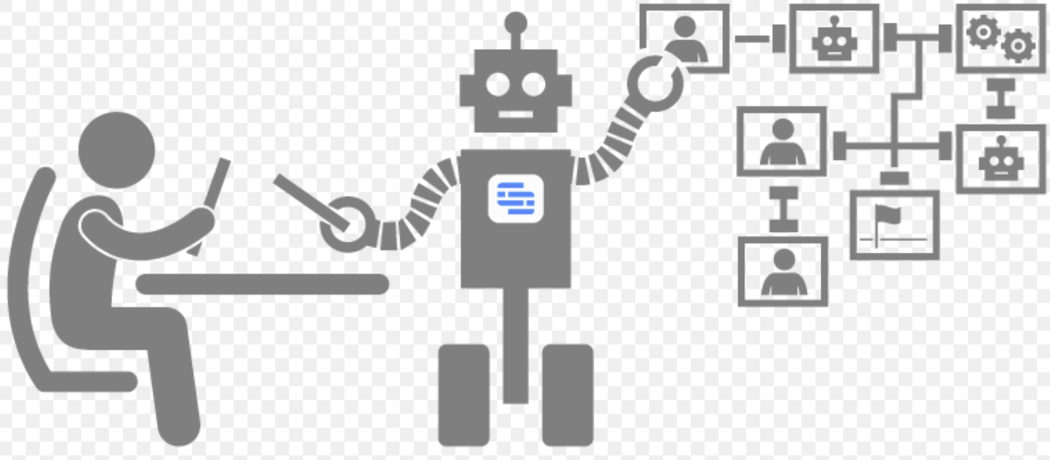
Cognitive automation
Robots will not have to replace people
The role of workers in the industry of the near future will be decisive.
Workers made even more skilled by information that they will receive in real time from machines, departments and warehouses

